Slide 1
LIFELINK
AI-Powered Blood & Organ Donor–Recipient Matching System
CAPSTONE PROJECT
Presented By:
Student Name - Shreya Kumari
College Name - Indian Institute of Technology patna
Department - Computer Science(Artificial Intelligence and Cyber Security)
AICTE ID - STU6968f6fa59ac01768486650

Slide 2
OUTLINE
Problem Statement (Should not include solution)
Proposed System/Solution
System Development Approach (Technology Used)
Algorithm & Deployment
Result
Conclusion
Future Scope
References

Slide 3
PROBLEM STATEMENT
During medical emergencies, finding a suitable blood or organ donor can be slow and difficult.
Donor information is often scattered across different sources.
Hospitals may struggle to identify compatible donors quickly.
Manual donor-recipient matching consumes valuable time.
Location and donor availability are important but difficult to consider simultaneously.
There is a need for a centralized platform that can prioritize compatible and nearby donors.
Delays in identifying suitable donors can affect emergency response.
Problem:
There is a need for a fast, intelligent and centralized system that can identify suitable blood or organ donors for recipients based on compatibility, location, urgency and availability.

Slide 4
PROPOSED SOLUTION
LifeLink is an AI-powered blood and organ donor-recipient matching platform designed to make emergency donor identification faster and more efficient. The system allows donors to register their blood type, organ willingness, location, and availability, while recipients or hospitals can submit urgent donation requests.
The platform uses an intelligent matching engine to identify suitable donors by analyzing blood/organ compatibility, geographic proximity, urgency level, and donor availability. Potential donors are ranked using a weighted matching score so that the most suitable matches can be identified quickly.
An AI-powered assistant helps users with donation-related queries, while the admin dashboard enables verification, monitoring, match management, and request status tracking. The system can also be extended with real-time notifications to immediately alert matched donors during emergencies.

Slide 5
SYSTEM APPROACH
LifeLink is developed as a Python-based AI-powered web application using Streamlit for the user interface and Google Gemini for the conversational AI assistant. The system follows a modular architecture with separate components for donor registration, recipient requests, matching, AI assistance, and admin management.
The core matching module processes donor and recipient information and calculates compatibility using blood/organ type, location, urgency, and availability. For the prototype, data is managed using Streamlit session state, while the system is designed to support PostgreSQL/PostGIS for persistent and location-based data management in future deployment.
Technologies Used: Python, Streamlit, Google Gemini API, IBM Bob, GitHub, PostgreSQL/PostGIS (planned).

Slide 6
ALGORITHM & DEPLOYMENT
Matching Algorithm: LifeLink uses a weighted scoring algorithm to rank potential donor-recipient matches. The system checks blood/organ compatibility, geographic proximity, urgency level, and donor availability to calculate a match score out of 100.
Processing: When a recipient submits an urgent request, the system analyzes the requirements, filters incompatible donors, calculates scores for eligible donors, and ranks them from the most suitable to the least suitable match. Score ≥ 80 is considered a strong match, 60–79 an acceptable match, and below 60 requires review.
Deployment: The prototype is built using Python and Streamlit, with Google Gemini powering the AI assistant. The application uses Streamlit Session State for data storage during the current session and can be deployed through Streamlit Cloud with the project maintained on GitHub.

Slide 7
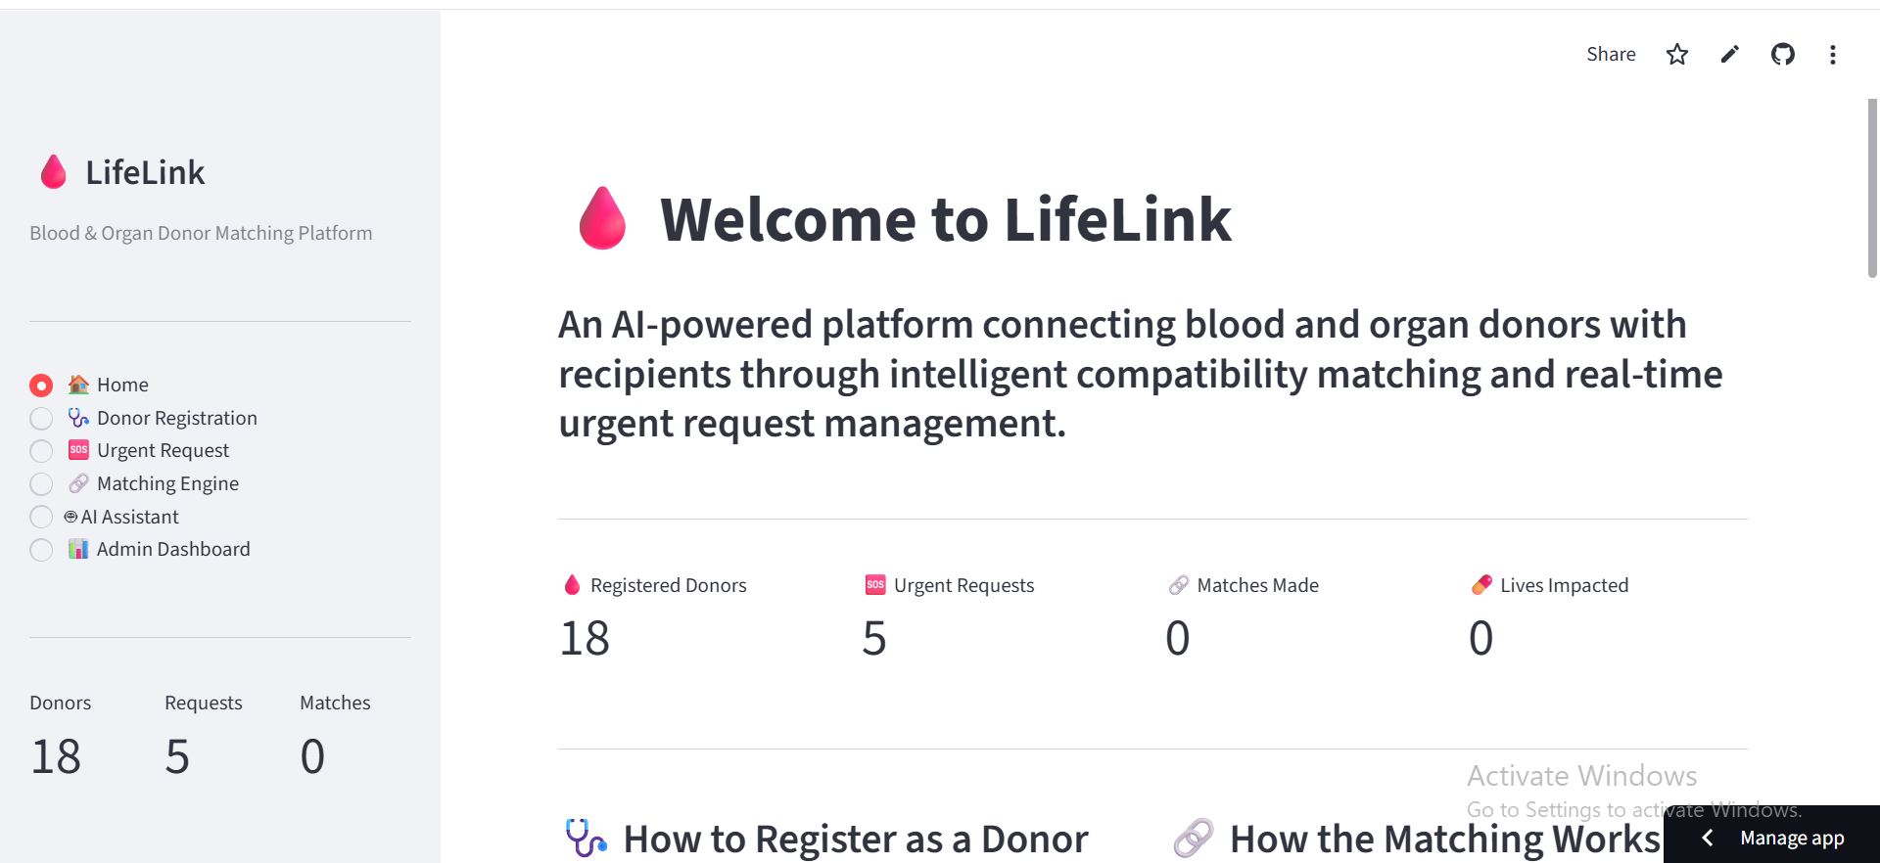
RESULT

Slide 8
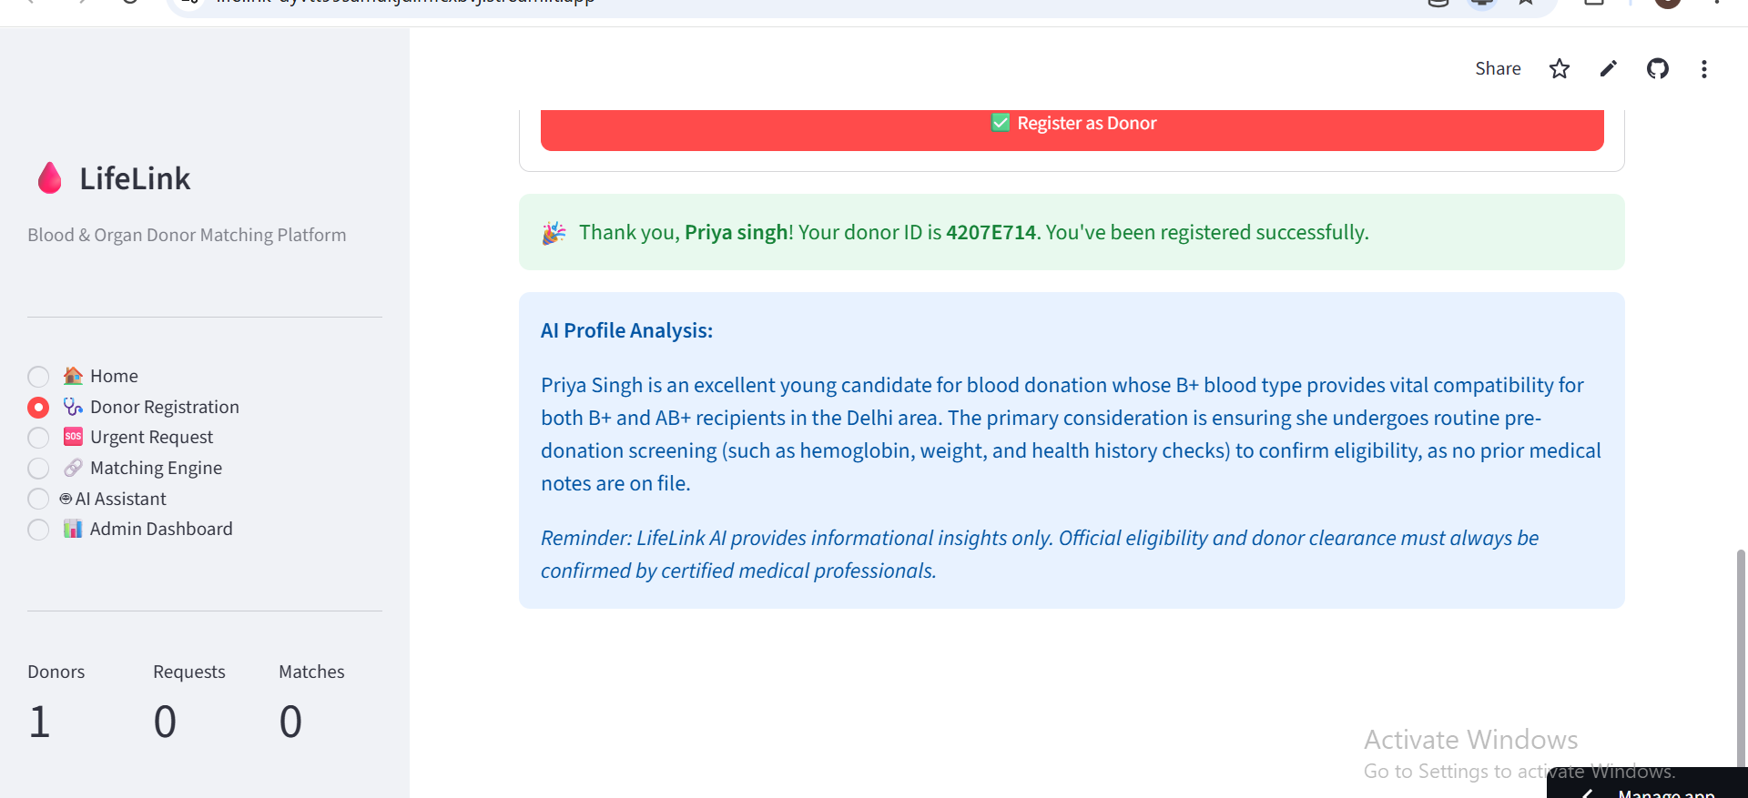

Slide 9
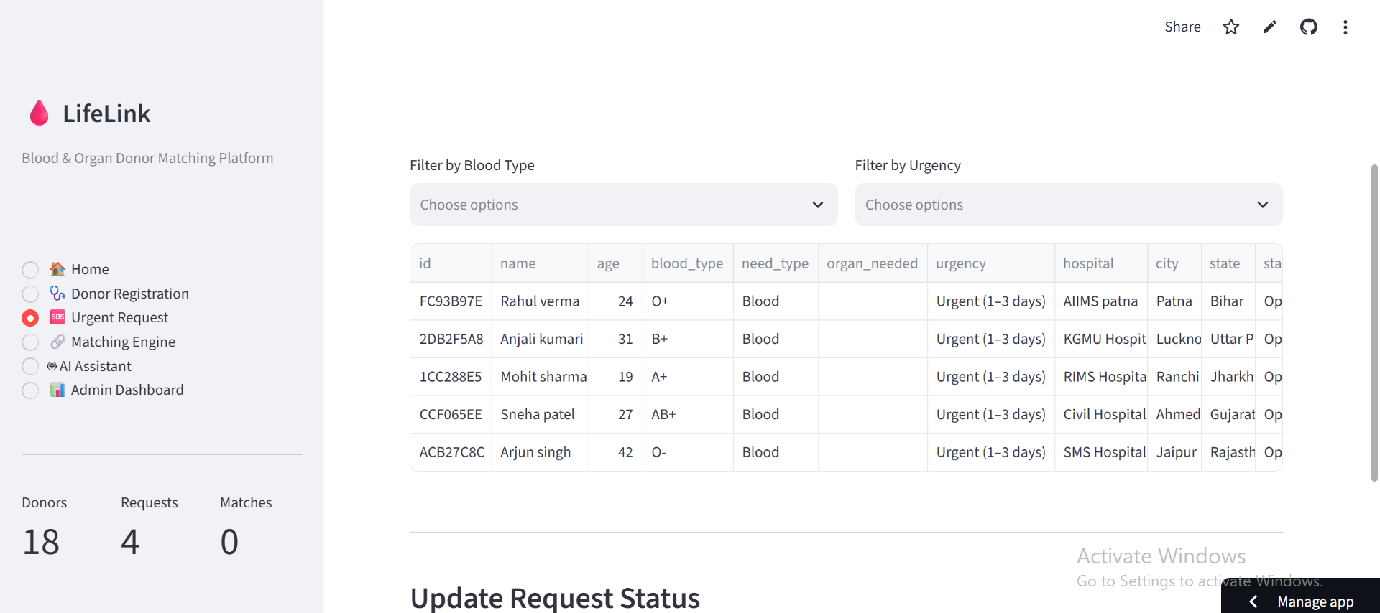

Slide 10
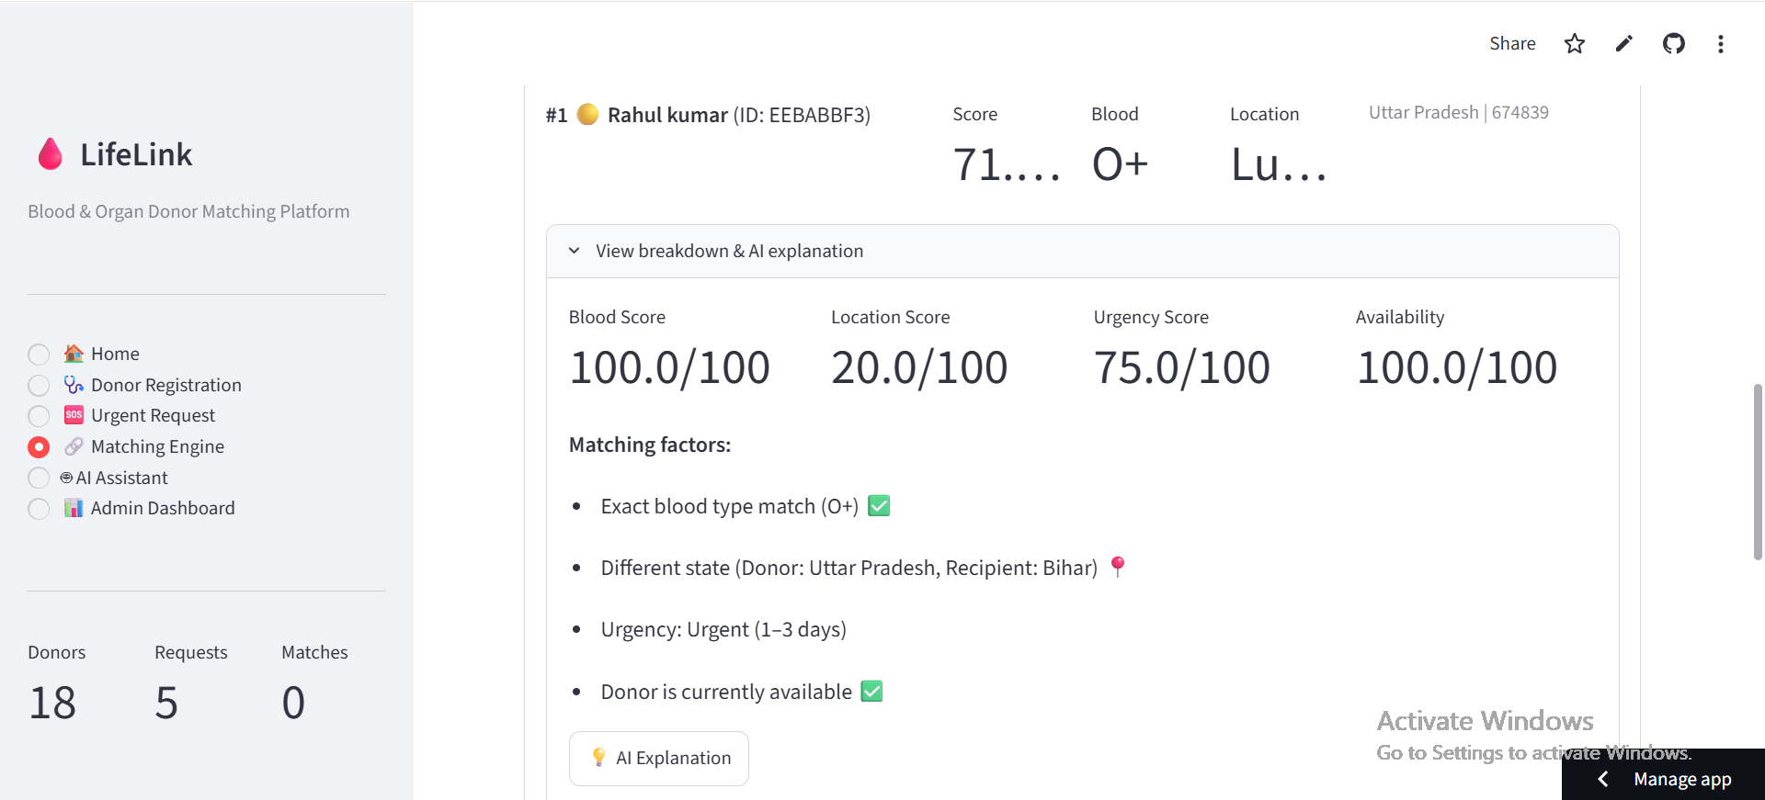

Slide 11
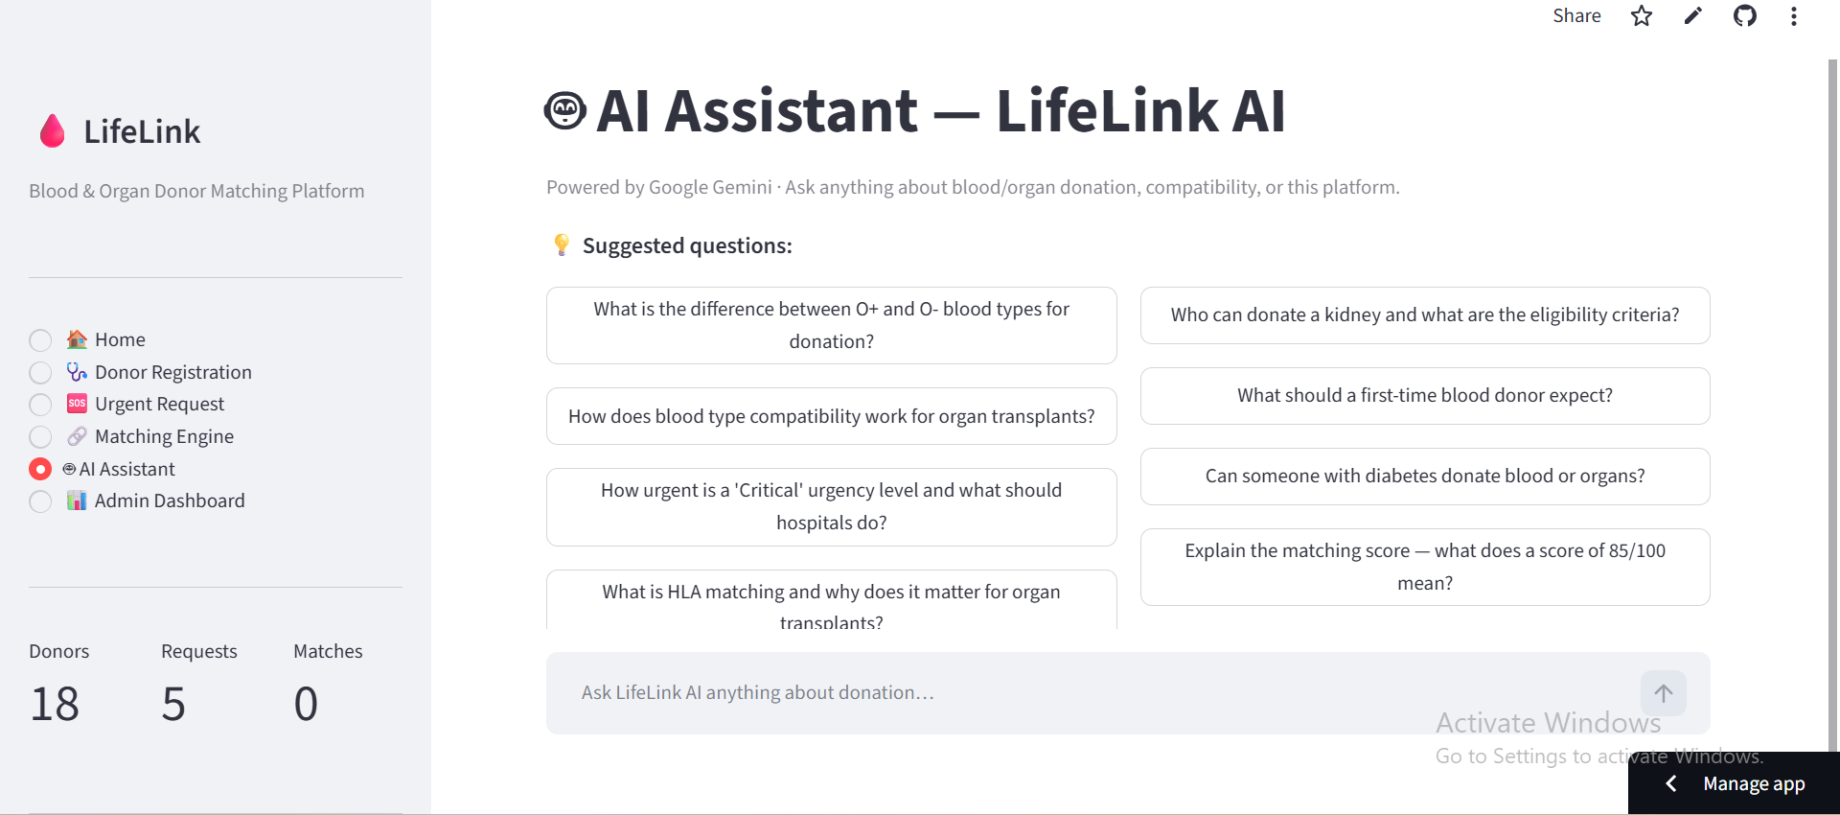

Slide 12
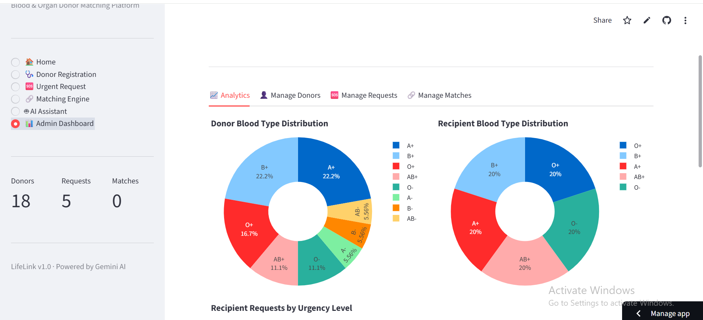

Slide 13
CONCLUSION
LifeLink provides an intelligent approach to connecting donors and recipients during emergency situations.
Key Achievements
Centralizes donor and recipient information.
Automates donor-recipient matching.
Combines compatibility, location, urgency and availability.
Reduces dependence on manual donor searching.
Provides an AI-powered conversational assistant.
Provides an administrative dashboard for monitoring.
Creates a foundation for a scalable national donor-matching platform.
Overall:
LifeLink demonstrates how AI and intelligent automation can help make emergency donor discovery faster, more organized and more accessible.

Slide 14
FUTURE SCOPE
In the future, LifeLink can be enhanced with a persistent cloud database to manage large-scale donor and recipient records. The platform can integrate real-time SMS, WhatsApp and push notifications for faster emergency communication. The matching engine can be improved using advanced AI-based ranking and predictive donor availability. A dedicated mobile application and direct hospital integration can further expand the system, enabling LifeLink to support regional and eventually national-level blood and organ donation networks.

Slide 15
REFERENCES
GitHub – LifeLink: Blood & Organ Donor Matching Platform
Python Documentation – Python programming language and libraries
Streamlit Documentation – Web application development and deployment
Google Gemini API Documentation – AI assistant integration
IBM Bob – AI-powered application development
GitHub Documentation – Version control and project repository management

Slide 16
DEPLOYMENT LINK / GITHUB LINK
Github Link: https://github.com/codedby-shreya/LifeLink.git
Deployment: https://lifelink-dyvtt99samukjdimfcxbvj.streamlit.app/
Streamlit

Slide 17
THANK YOU

